Slide 1



Business Insights 360
View in Power BI
Last data refresh:
10/20/2023 4:30:16 PM UTC
Downloaded at:
10/20/2023 4:39:24 PM UTC

Slide 2
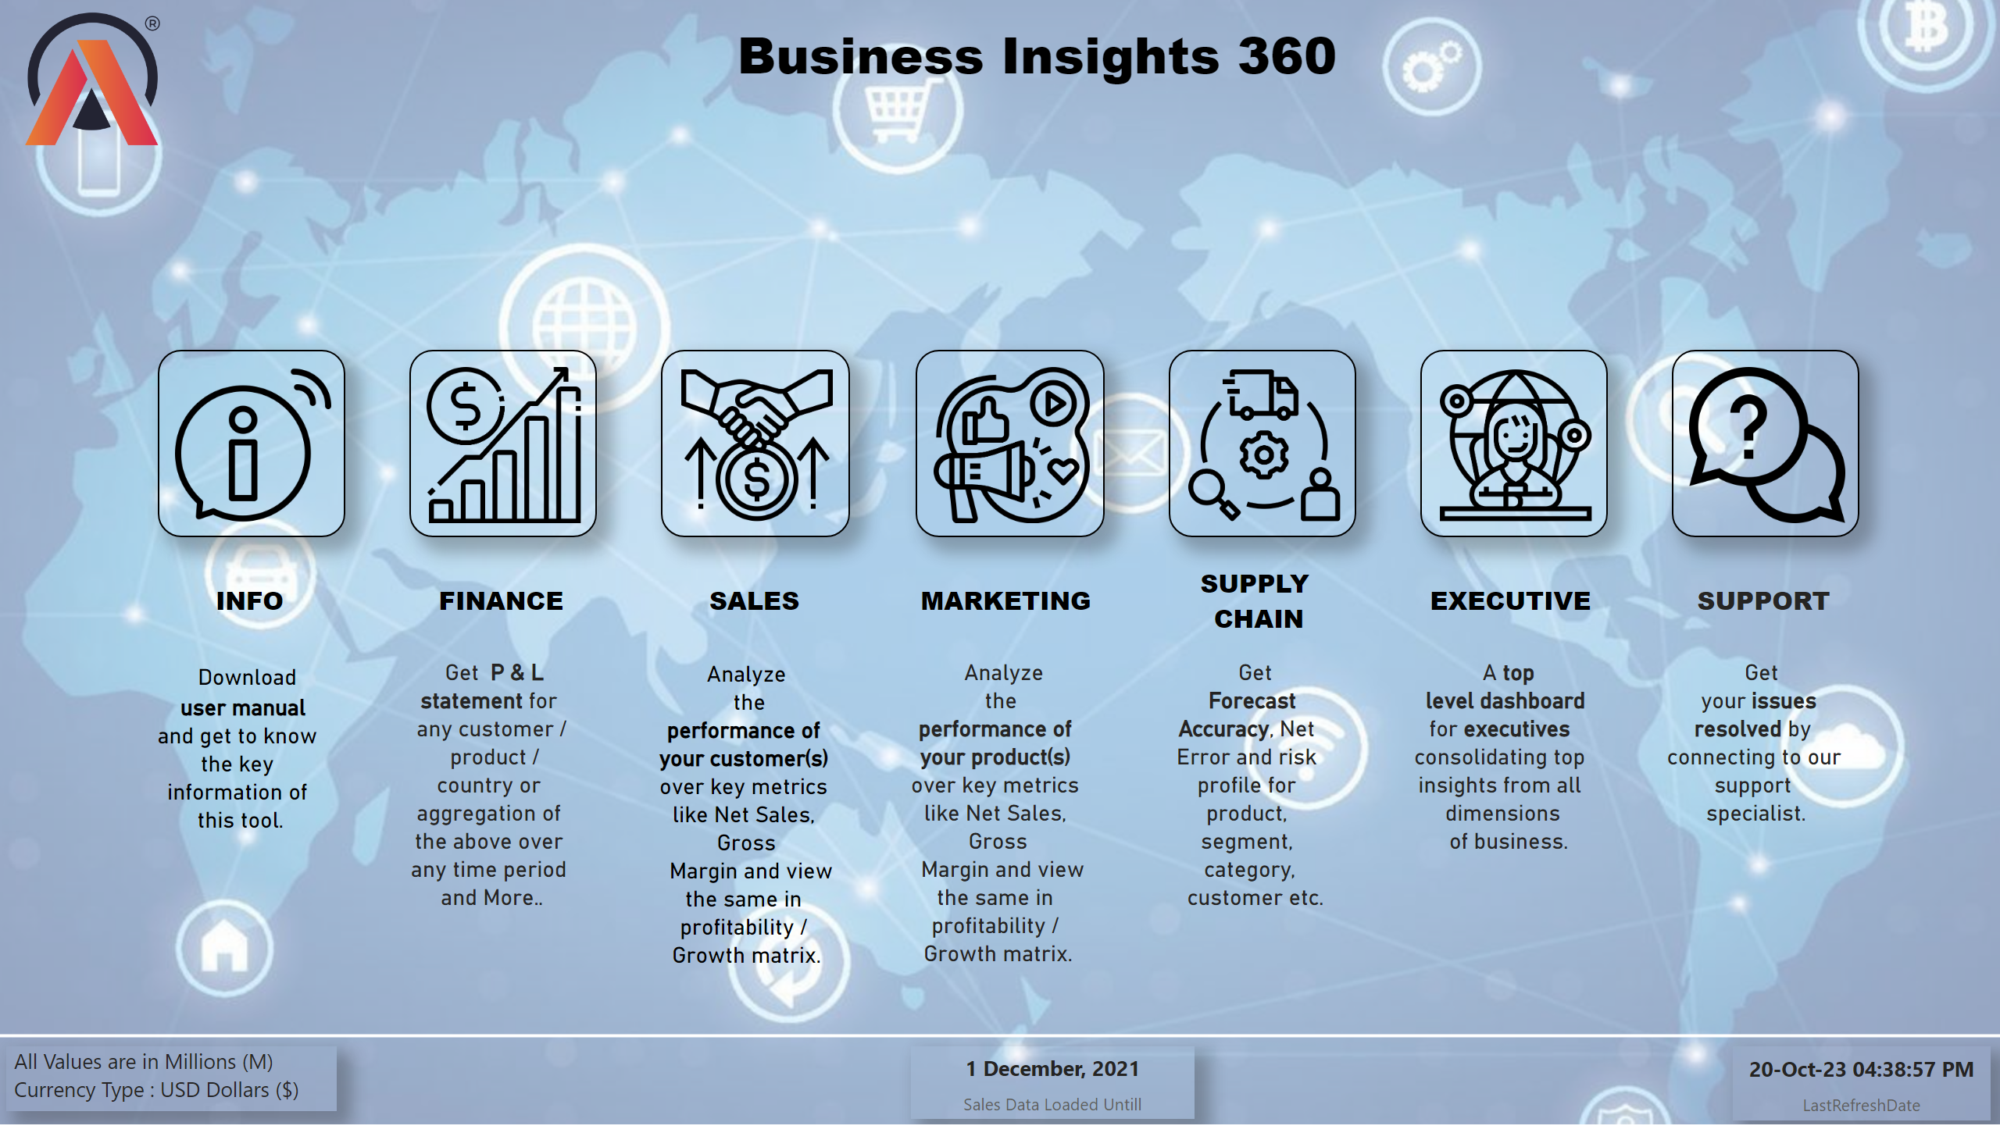
Home
Notes:
image
No alt text provided
Info
No alt text provided
image
No alt text provided
image
No alt text provided
image
No alt text provided
image
No alt text provided
image
No alt text provided
image
No alt text provided
textbox
No alt text provided
textbox
No alt text provided
textbox
No alt text provided
textbox
No alt text provided
textbox
No alt text provided
textbox
No alt text provided
textbox
No alt text provided
textbox
No alt text provided
textbox
No alt text provided
textbox
No alt text provided
textbox
No alt text provided
textbox
No alt text provided
textbox
No alt text provided
textbox
No alt text provided
textbox
No alt text provided
textbox
No alt text provided
shape
No alt text provided
card
No alt text provided
card
No alt text provided

Slide 3
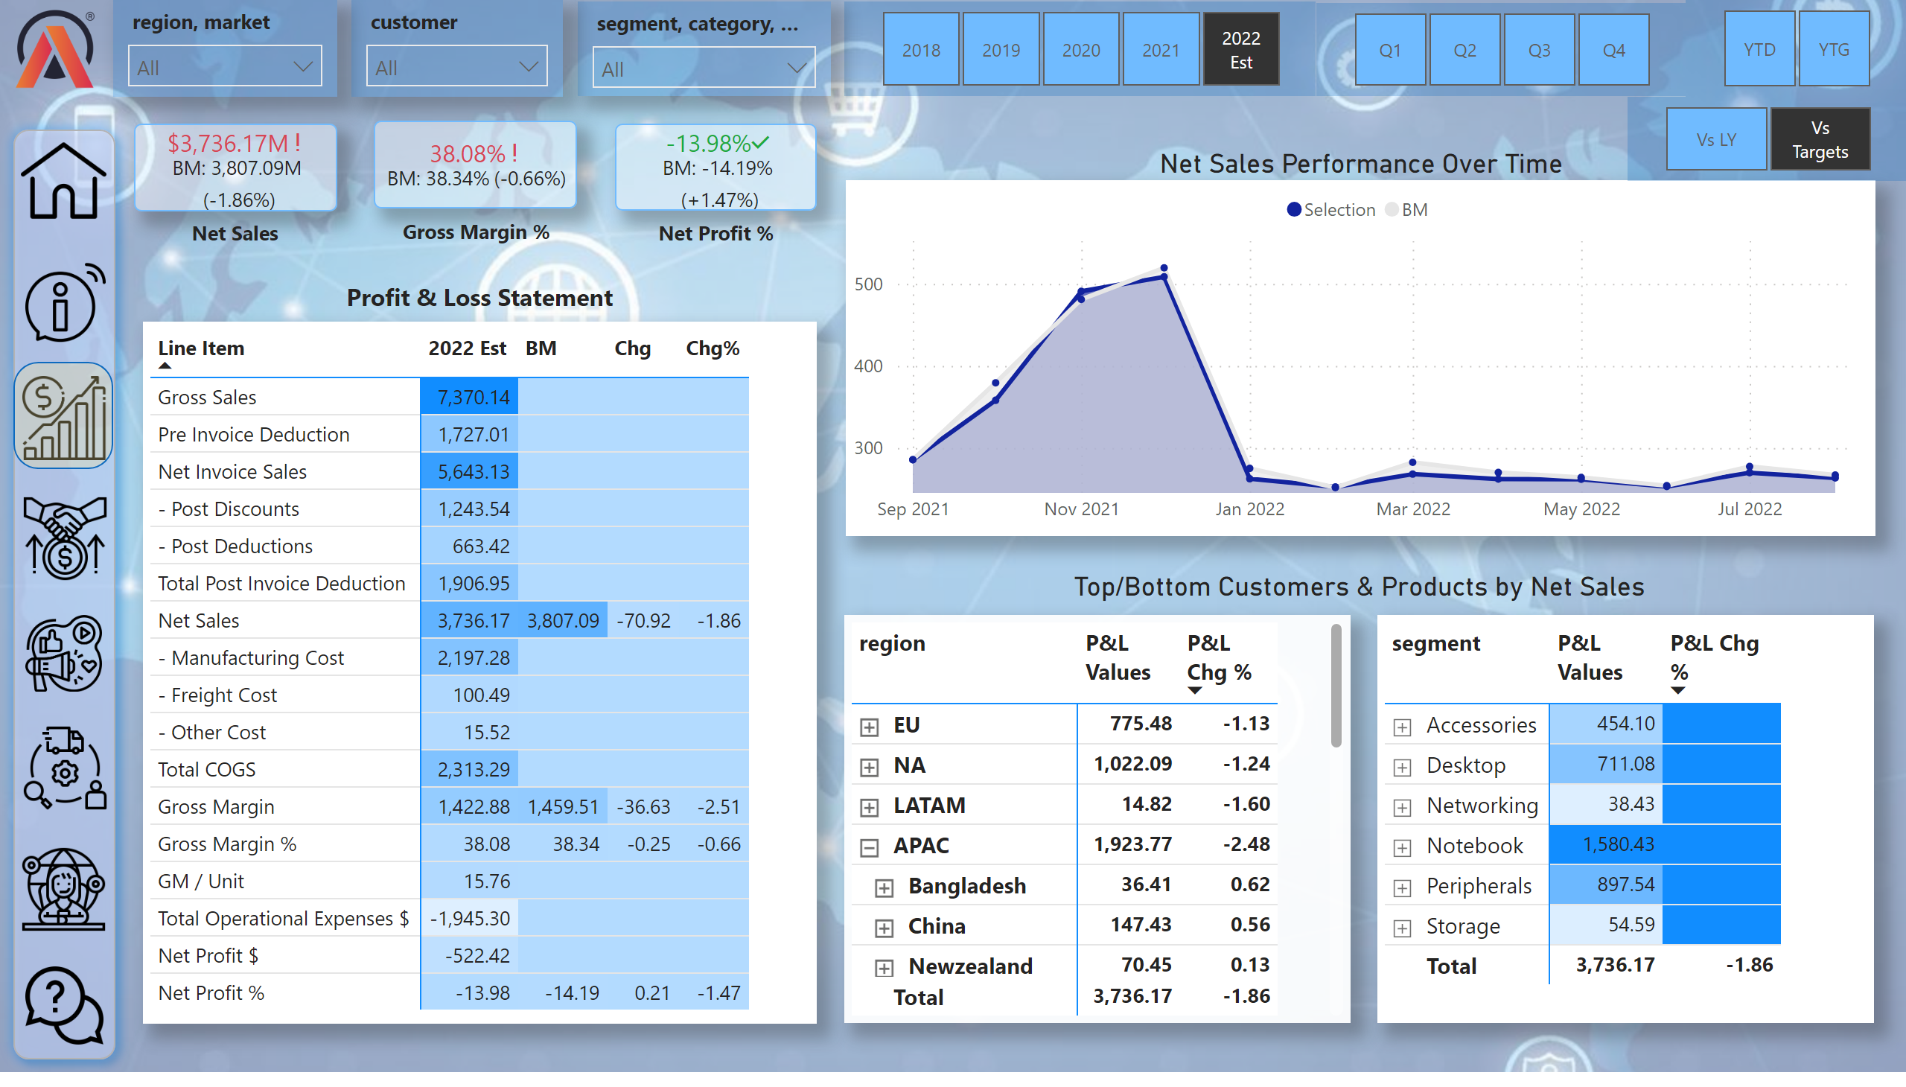
Finance View
Notes:
slicer
No alt text provided
pivotTable
No alt text provided
Net Sales Performance Over Time
No alt text provided
pivotTable
No alt text provided
pivotTable
No alt text provided
card
No alt text provided
card
No alt text provided
textbox
No alt text provided
slicer
No alt text provided
slicer
No alt text provided
slicer
No alt text provided
slicer
No alt text provided
slicer
No alt text provided
kpi
No alt text provided
kpi
No alt text provided
textbox
No alt text provided
textbox
No alt text provided
textbox
No alt text provided
image
No alt text provided
shape
No alt text provided
image
No alt text provided
image
No alt text provided
image
No alt text provided
image
No alt text provided
image
No alt text provided
image
No alt text provided
image
No alt text provided
image
No alt text provided
shape
No alt text provided
slicer
No alt text provided
kpi
No alt text provided
card
No alt text provided

Slide 4
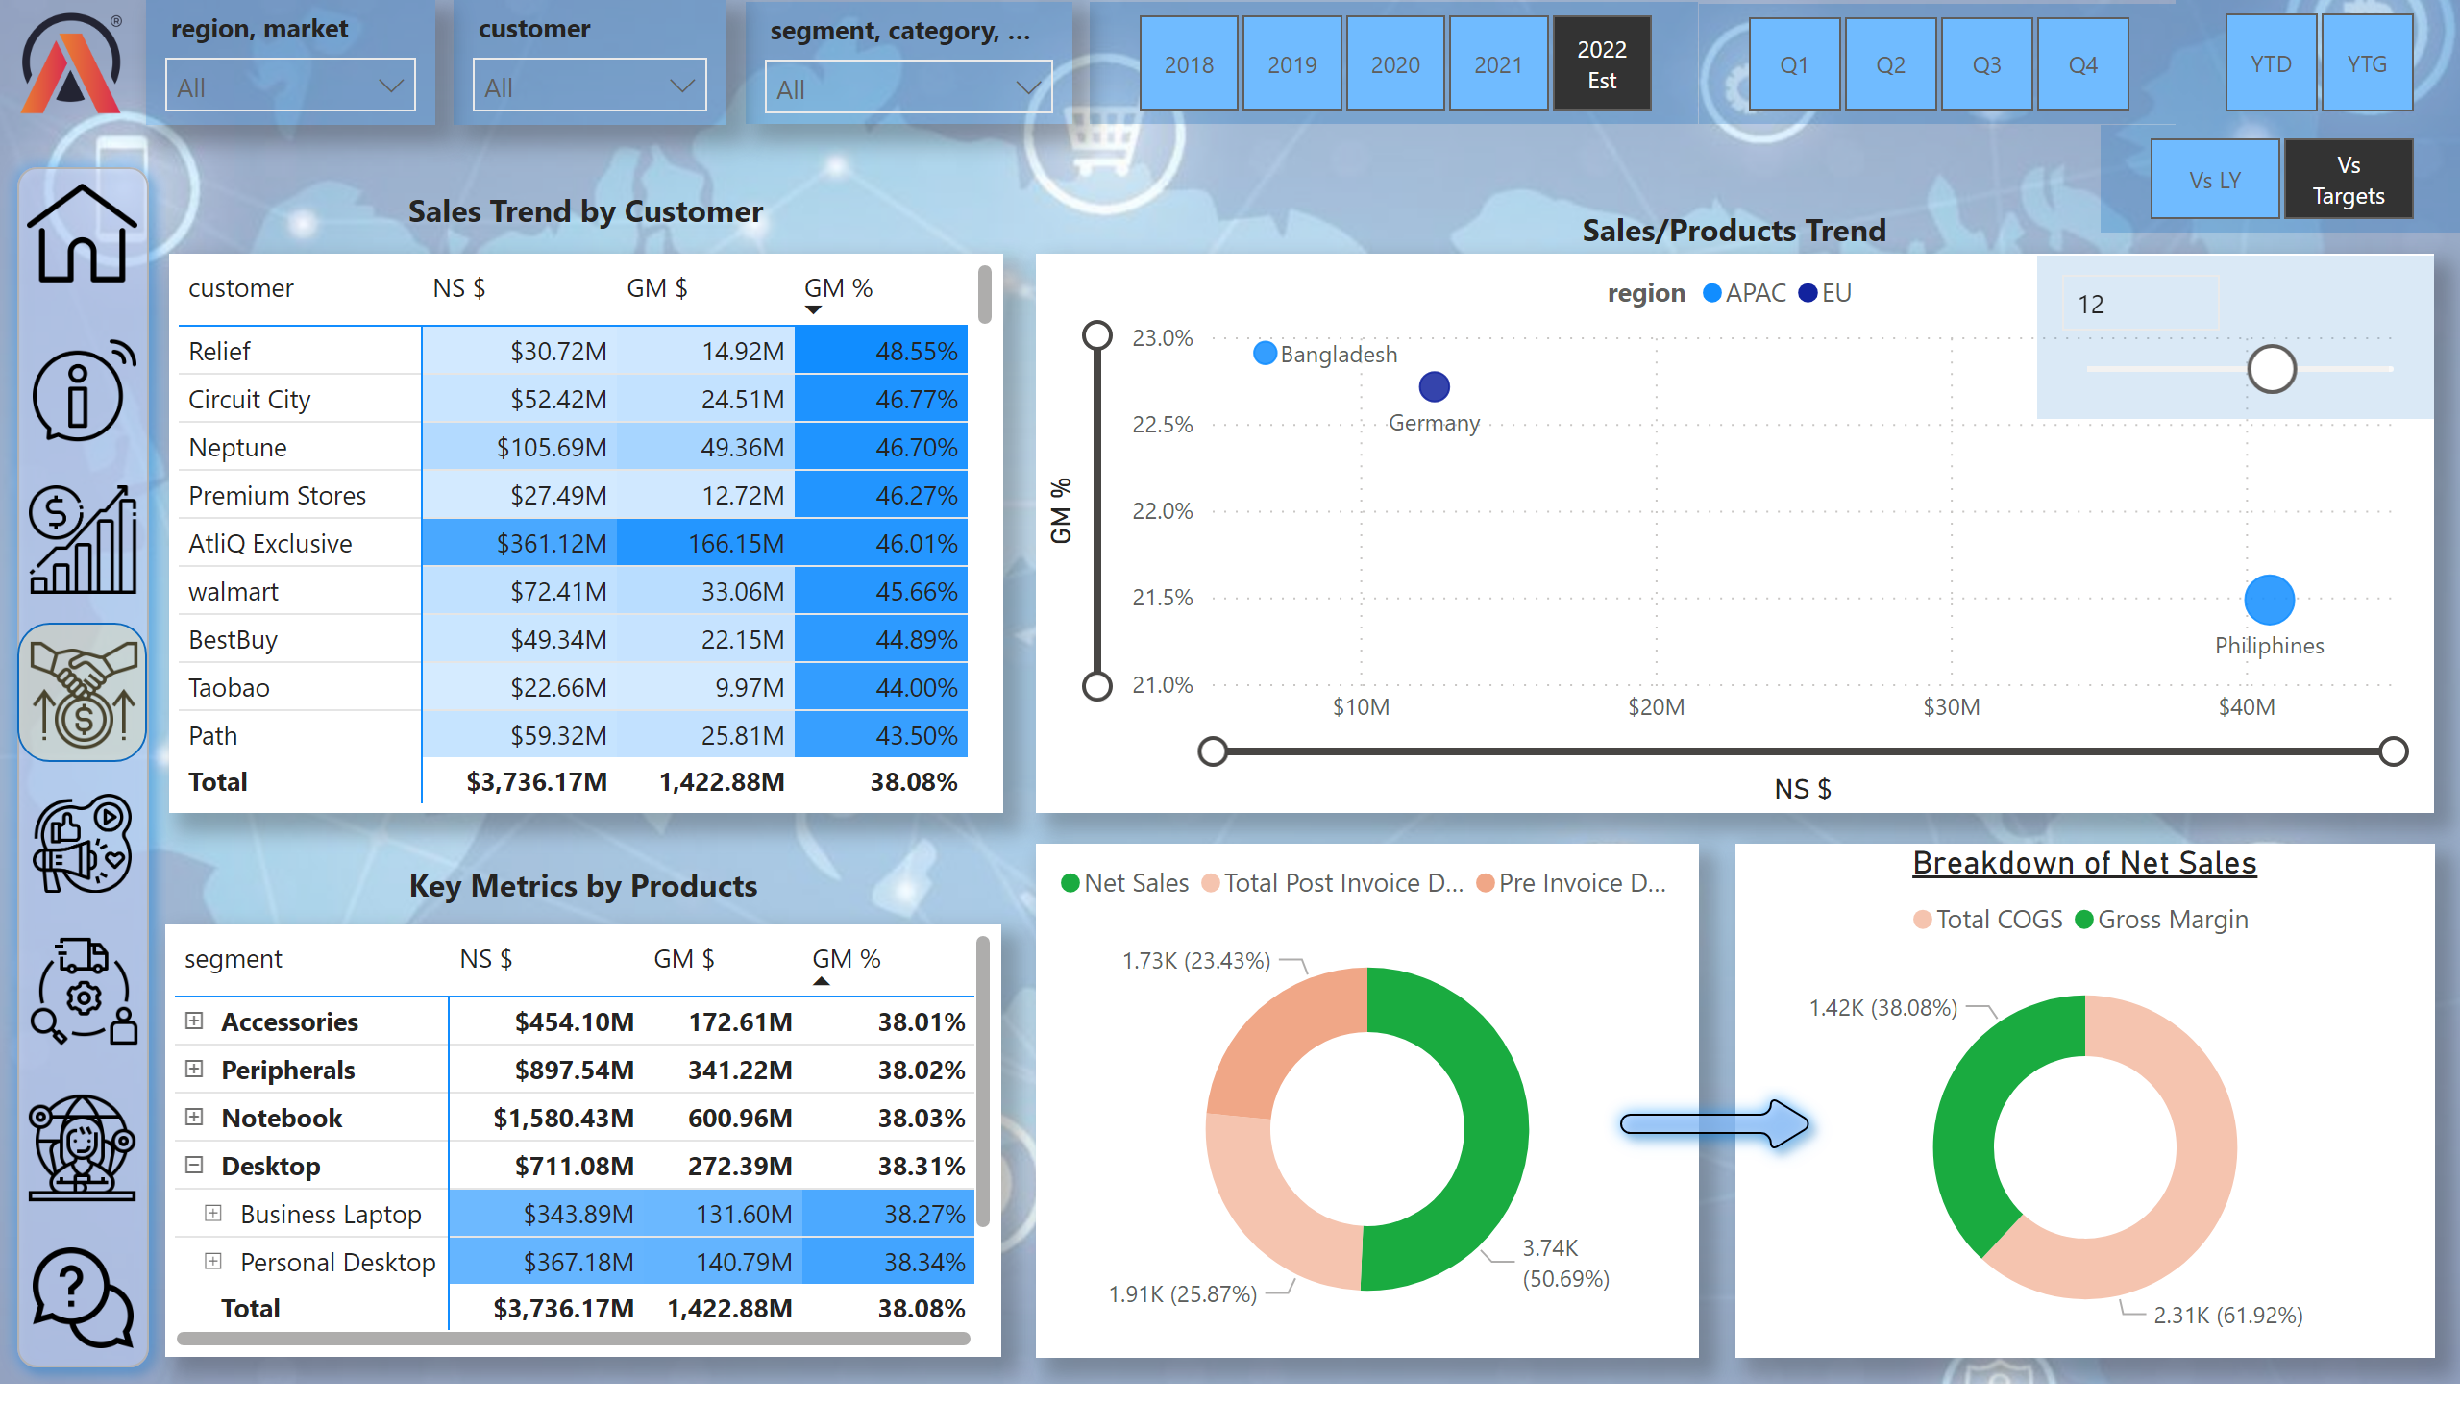
Sales View
Notes:
slicer
No alt text provided
textbox
No alt text provided
slicer
No alt text provided
slicer
No alt text provided
slicer
No alt text provided
slicer
No alt text provided
slicer
No alt text provided
image
No alt text provided
shape
No alt text provided
image
No alt text provided
image
No alt text provided
image
No alt text provided
image
No alt text provided
image
No alt text provided
image
No alt text provided
image
No alt text provided
image
No alt text provided
shape
No alt text provided
pivotTable
No alt text provided
pivotTable
No alt text provided
textbox
No alt text provided
scatterChart
No alt text provided
textbox
No alt text provided
donutChart
No alt text provided
Breakdown of Net Sales
No alt text provided
shape
No alt text provided
slicer
No alt text provided
slicer
No alt text provided

Slide 5
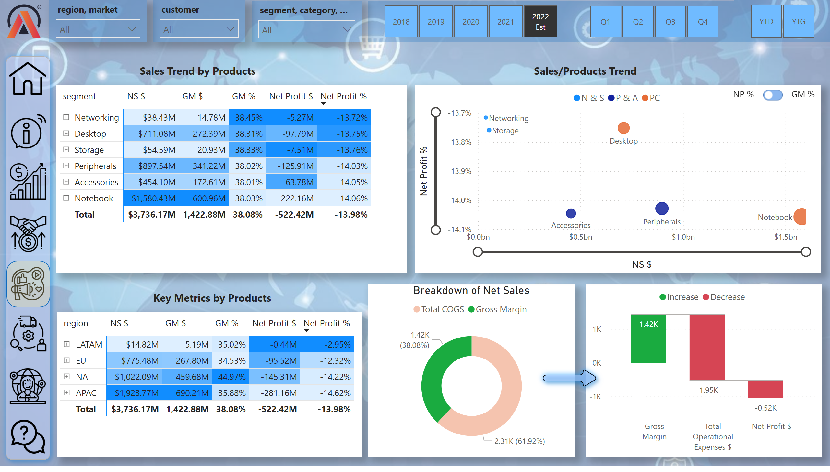
Marketing View
Notes:
slicer
No alt text provided
textbox
No alt text provided
slicer
No alt text provided
slicer
No alt text provided
slicer
No alt text provided
slicer
No alt text provided
slicer
No alt text provided
image
No alt text provided
shape
No alt text provided
image
No alt text provided
image
No alt text provided
image
No alt text provided
image
No alt text provided
image
No alt text provided
image
No alt text provided
image
No alt text provided
image
No alt text provided
shape
No alt text provided
textbox
No alt text provided
textbox
No alt text provided
pivotTable
No alt text provided
scatterChart
No alt text provided
pivotTable
No alt text provided
Breakdown of Net Sales
No alt text provided
Breakdown of Net Sales
No alt text provided
ARROW
No alt text provided
scatterChart
No alt text provided
GM% on button
No alt text provided
NP% on button
No alt text provided
image
No alt text provided
ON BUTTON NP%
No alt text provided

Slide 6
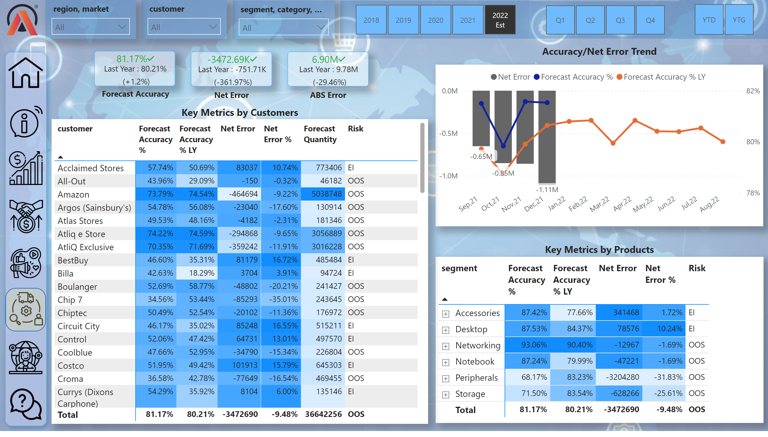
Supply Chain View
Notes:
slicer
No alt text provided
textbox
No alt text provided
slicer
No alt text provided
slicer
No alt text provided
slicer
No alt text provided
slicer
No alt text provided
slicer
No alt text provided
kpi
No alt text provided
kpi
No alt text provided
kpi
No alt text provided
textbox
No alt text provided
textbox
No alt text provided
textbox
No alt text provided
image
No alt text provided
shape
No alt text provided
image
No alt text provided
image
No alt text provided
image
No alt text provided
image
No alt text provided
image
No alt text provided
image
No alt text provided
image
No alt text provided
image
No alt text provided
shape
No alt text provided
lineStackedColumnComboChart
No alt text provided
pivotTable
No alt text provided
pivotTable
No alt text provided
textbox
No alt text provided
textbox
No alt text provided

Slide 7
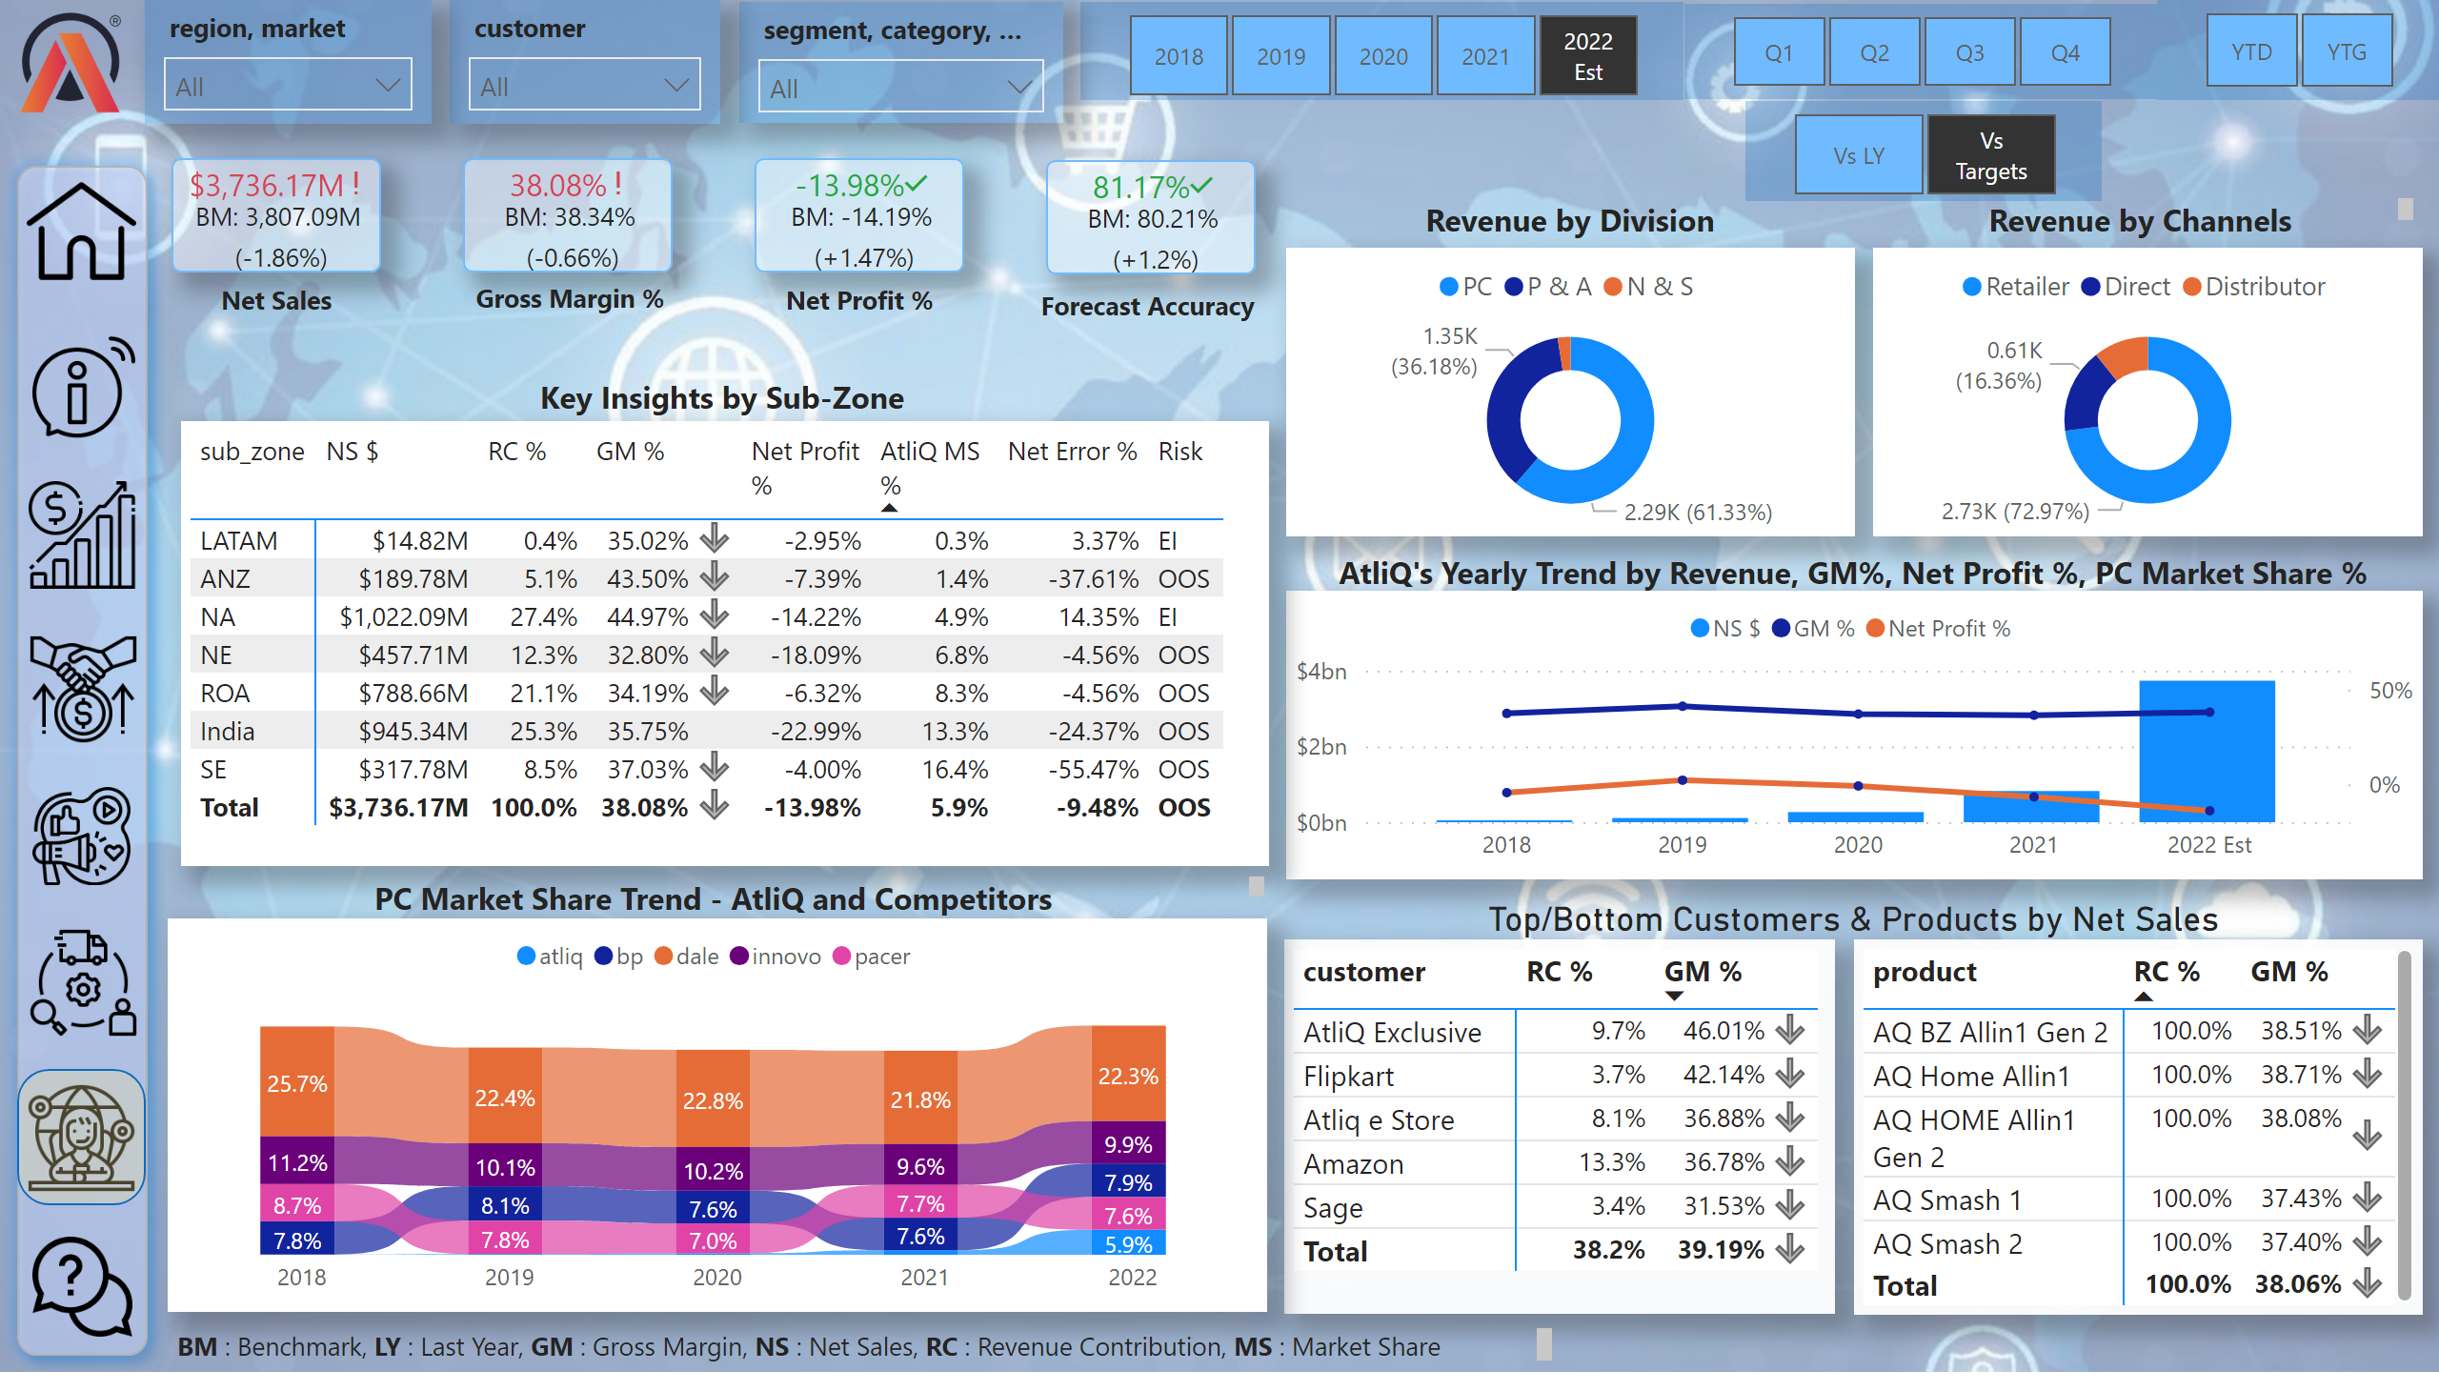
Executive View
Notes:
slicer
No alt text provided
Net Sales Performance Over Time
No alt text provided
pivotTable
No alt text provided
card
No alt text provided
textbox
No alt text provided
slicer
No alt text provided
slicer
No alt text provided
slicer
No alt text provided
slicer
No alt text provided
slicer
No alt text provided
kpi
No alt text provided
kpi
No alt text provided
textbox
No alt text provided
textbox
No alt text provided
textbox
No alt text provided
image
No alt text provided
shape
No alt text provided
image
No alt text provided
image
No alt text provided
image
No alt text provided
image
No alt text provided
image
No alt text provided
image
No alt text provided
image
No alt text provided
image
No alt text provided
shape
No alt text provided
slicer
No alt text provided
kpi
No alt text provided
card
No alt text provided
textbox
No alt text provided
kpi
No alt text provided
ribbonChart
No alt text provided
pivotTable
No alt text provided
donutChart
No alt text provided
donutChart
No alt text provided
textbox
No alt text provided
textbox
No alt text provided
textbox
No alt text provided
textbox
No alt text provided
textbox
No alt text provided
pivotTable
No alt text provided

